Slide 1

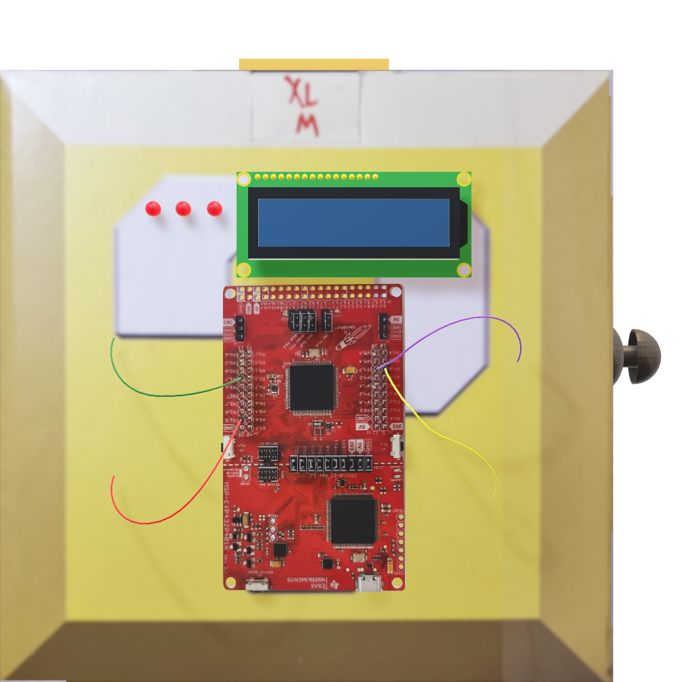

Slide 2
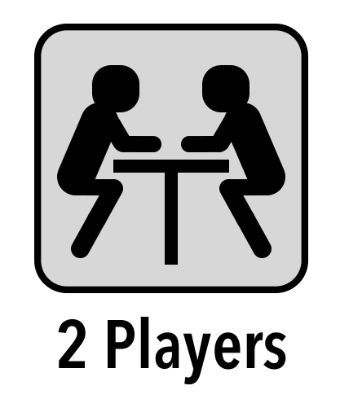

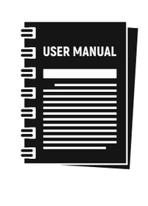


THE IDEA
disarmer
helper
Notes:
The project wanted to recreate the game “keep talking and nobody explodes” where two players have to disarm a bomb.
One player has the bomb and can interact with it, meanwhile the other have the manual containing the instruction to disarm it. The interesting mechanic is that they are not allowed to see each other, they can only exchange information through talking with each other.
That from now on will be referred as disarmer and helper.

Slide 3
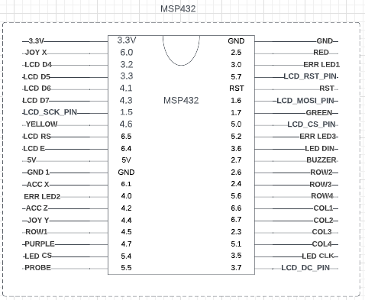
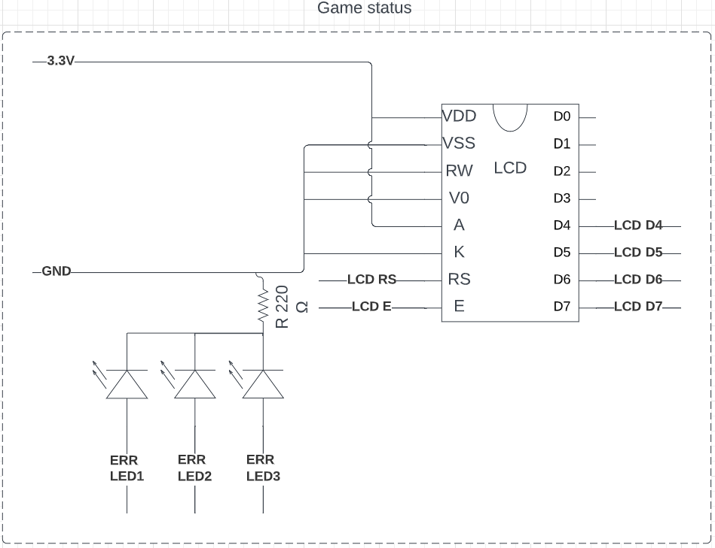

TIME AND ERRORS
SN NUMBER 3:24
Notes:
The players will have to solve 4 different puzzles within a time limit and a maximum of 3 errors, each time an error occurs the timer and music speeds up pressuring the players to move faster and possibly make more mistakes.

Slide 4
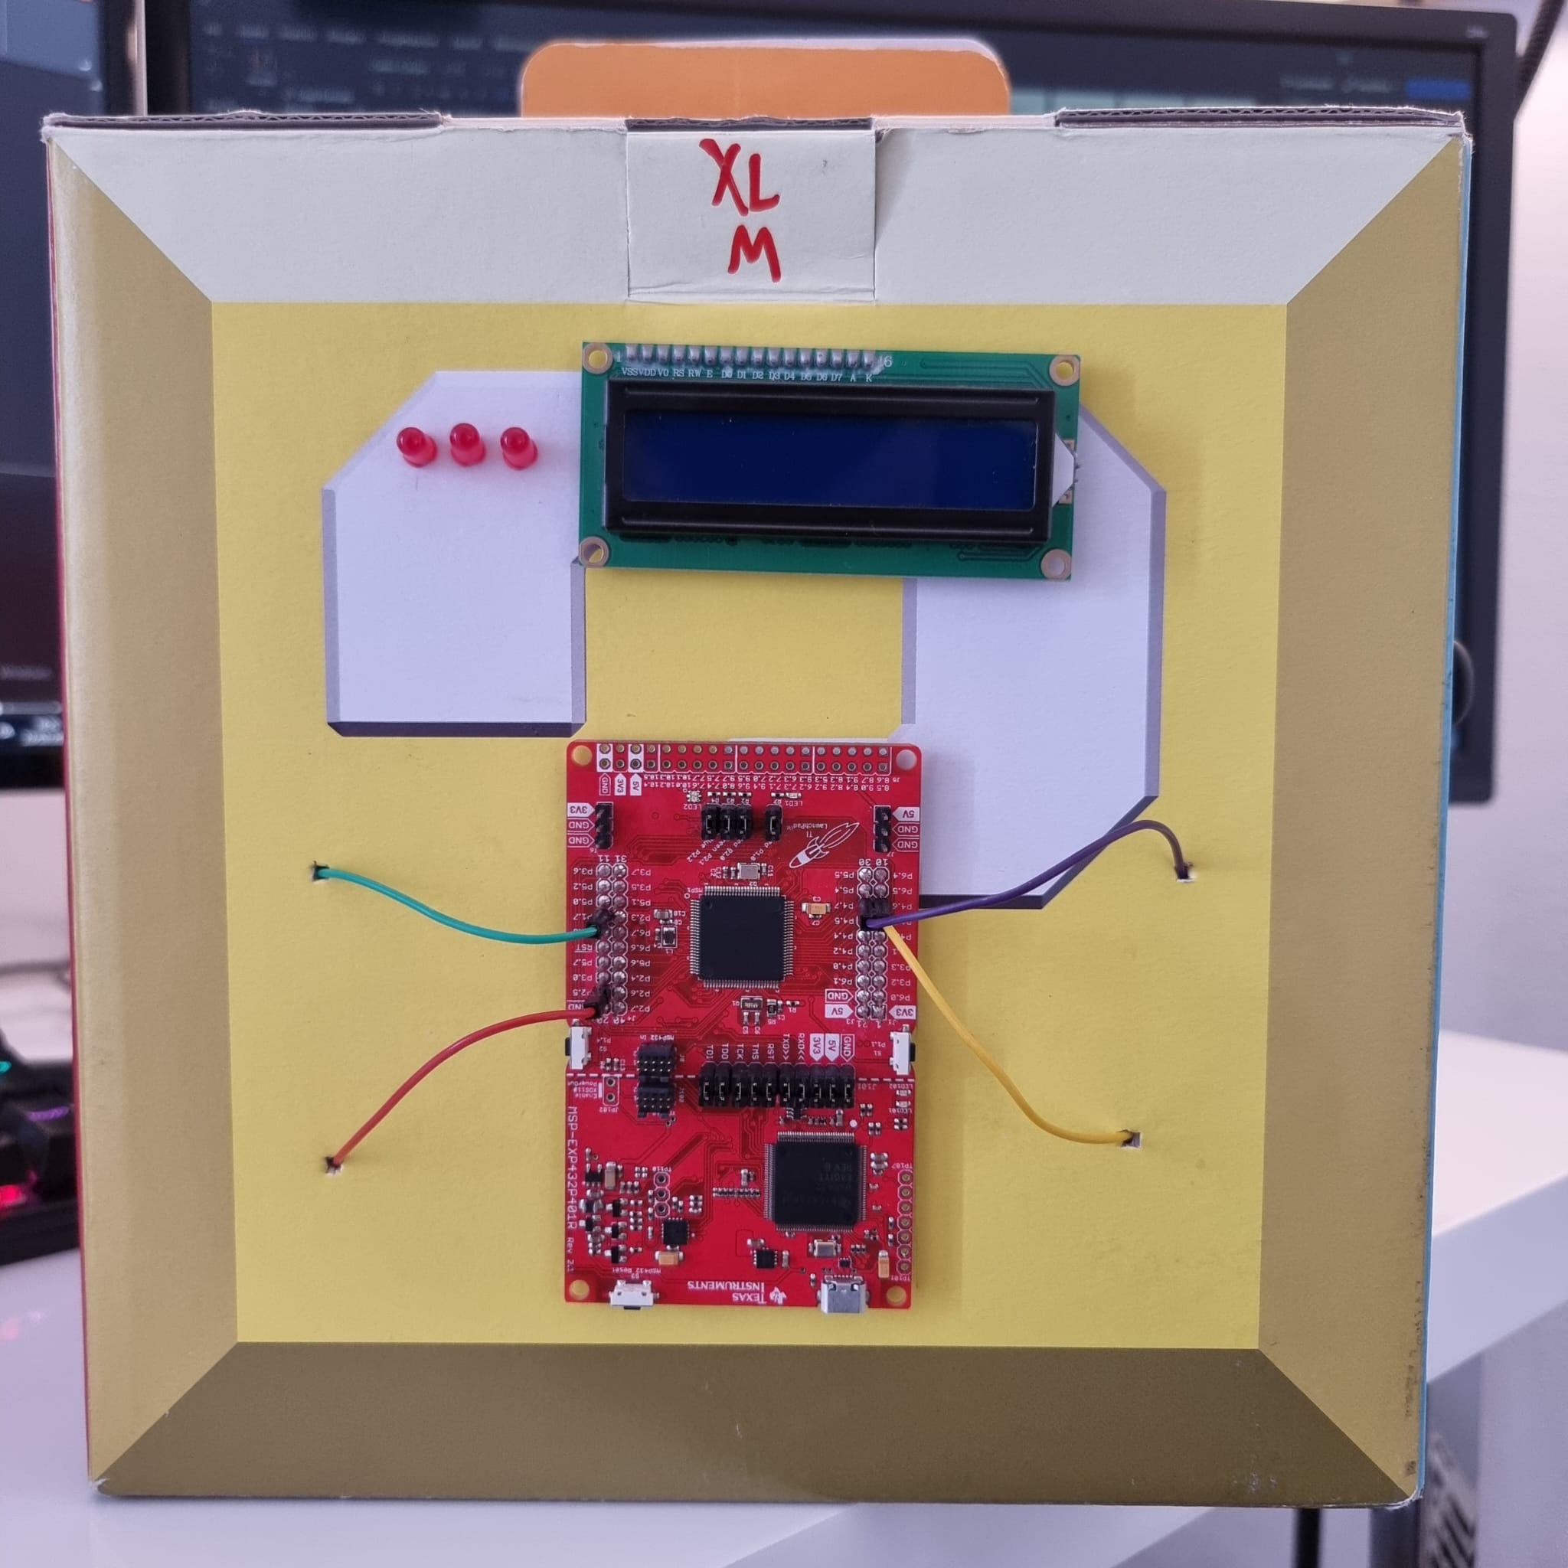
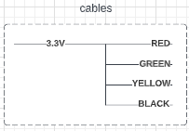

MODULES
CABLES
Notes:
In this puzzle we need to remove one or more cables from the MSP.

Slide 5
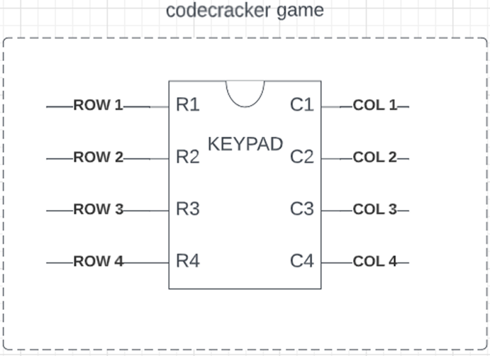
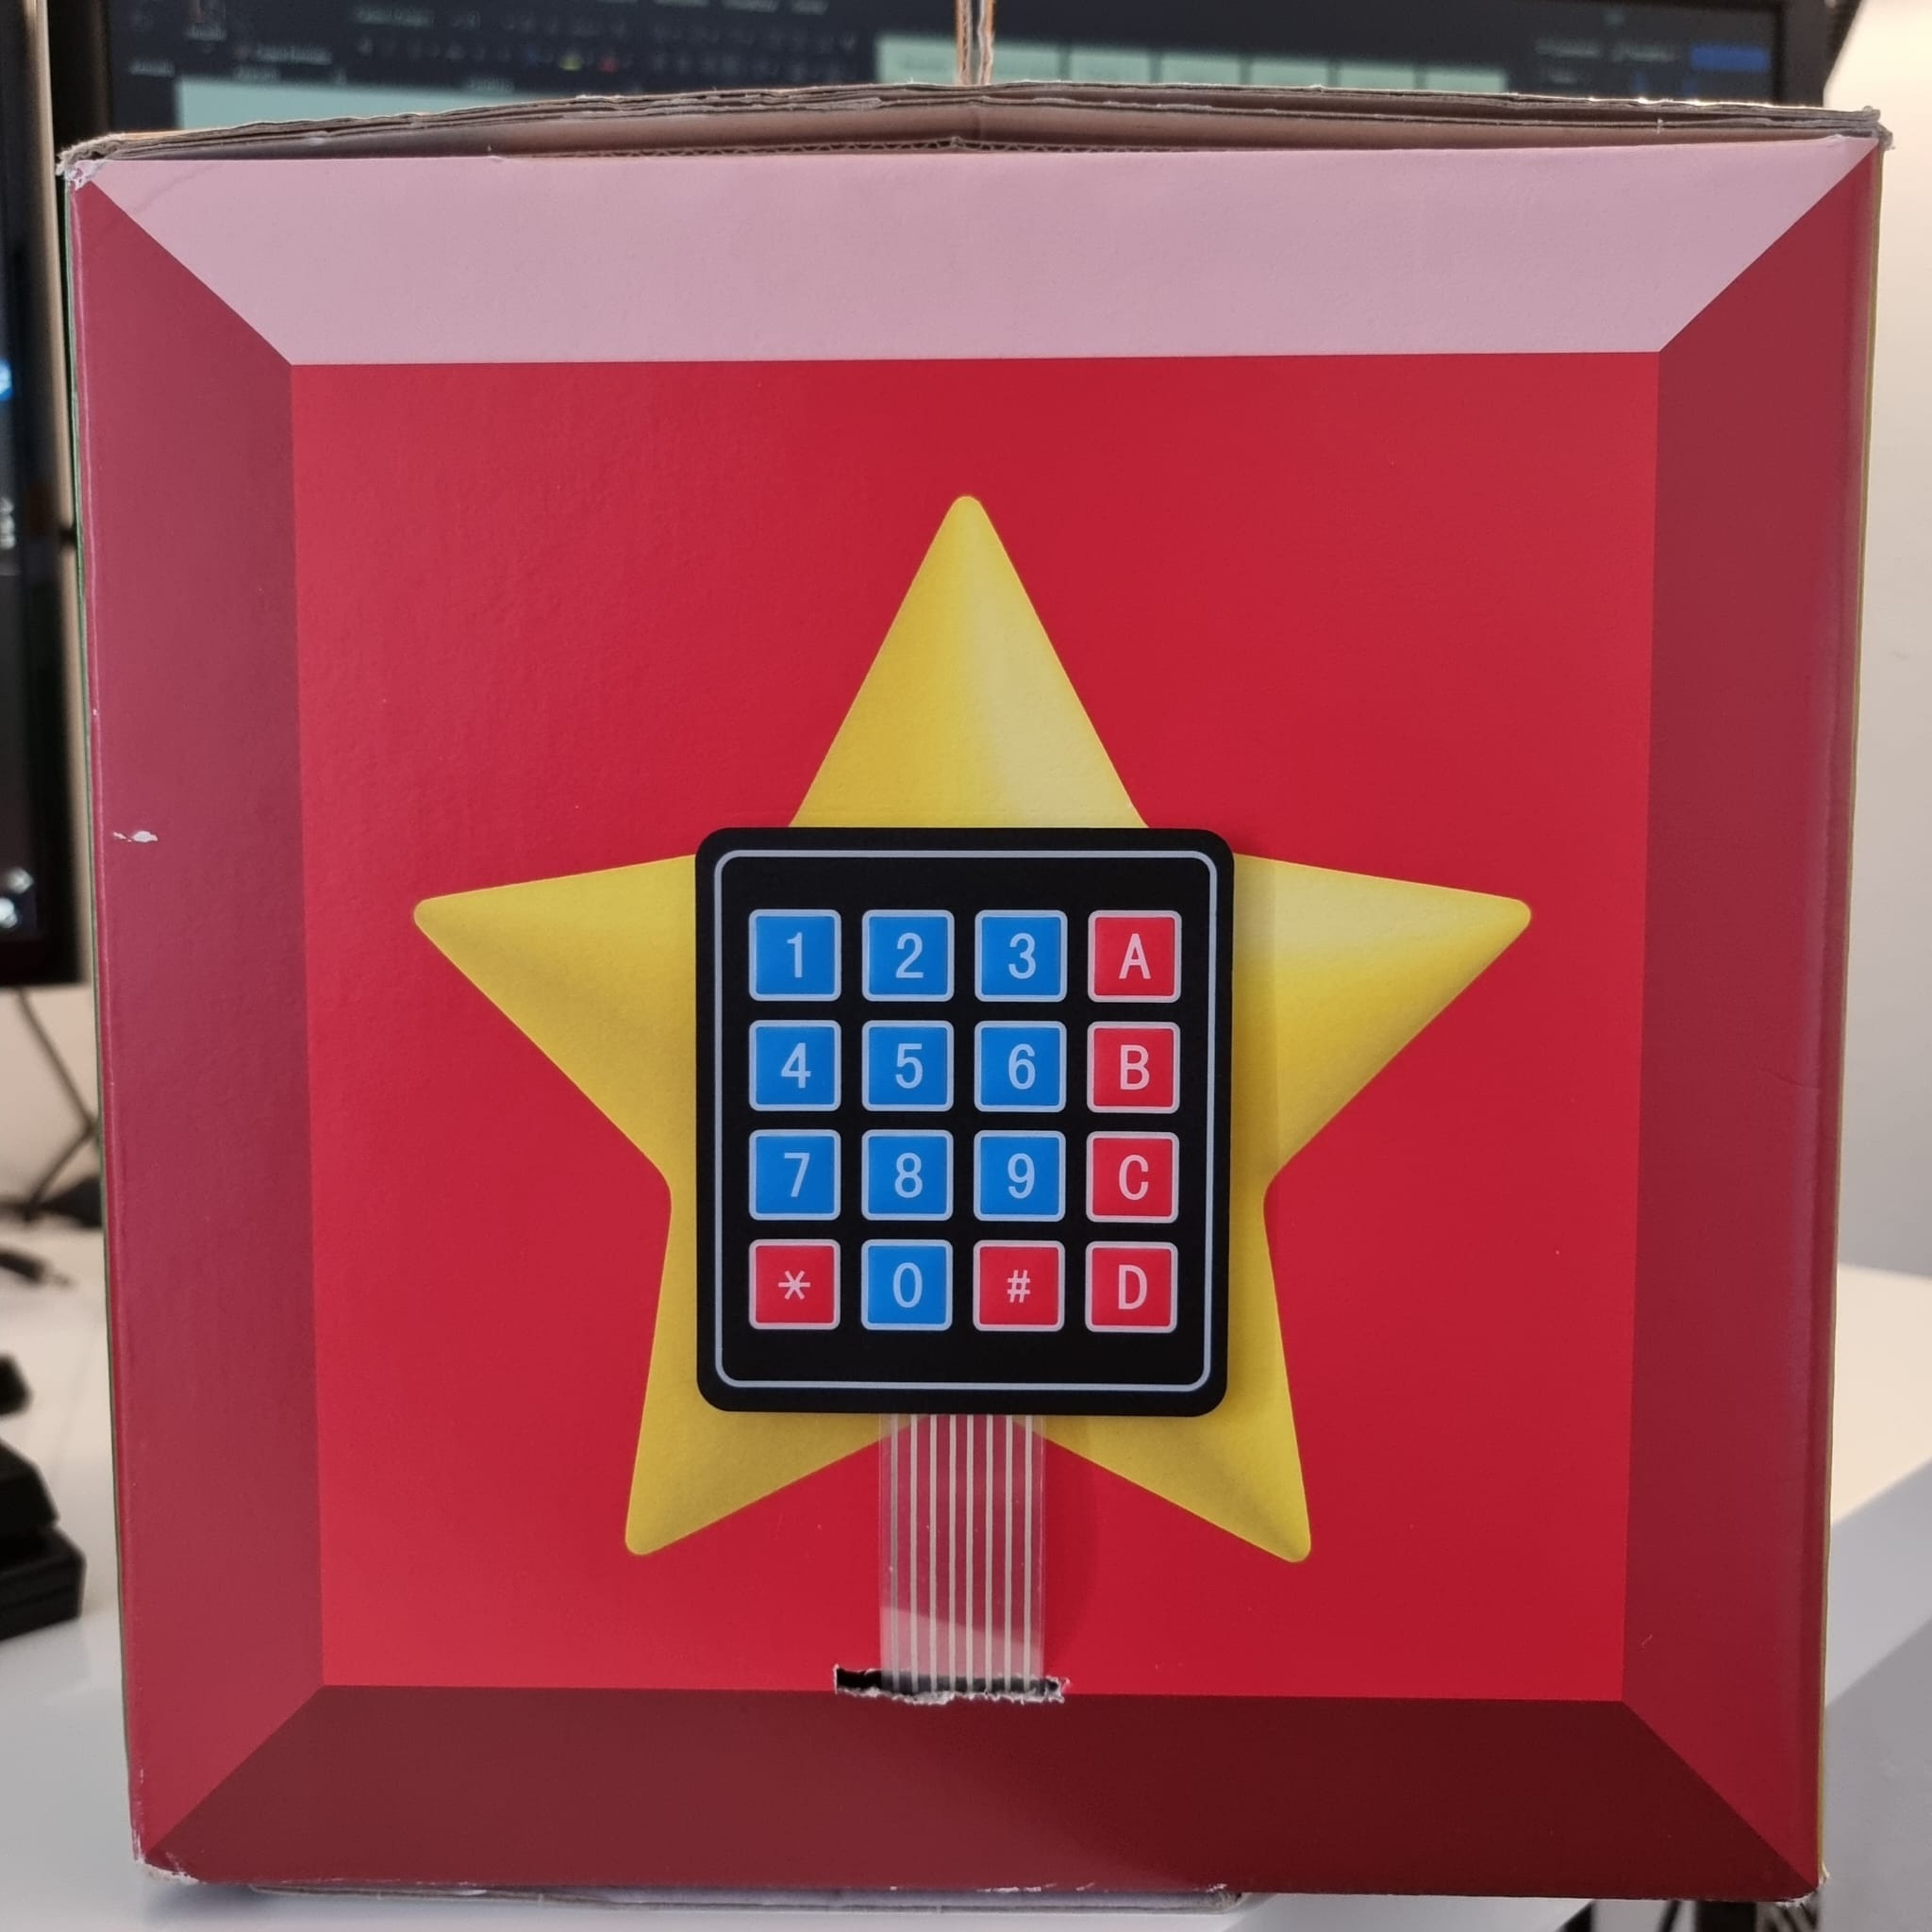
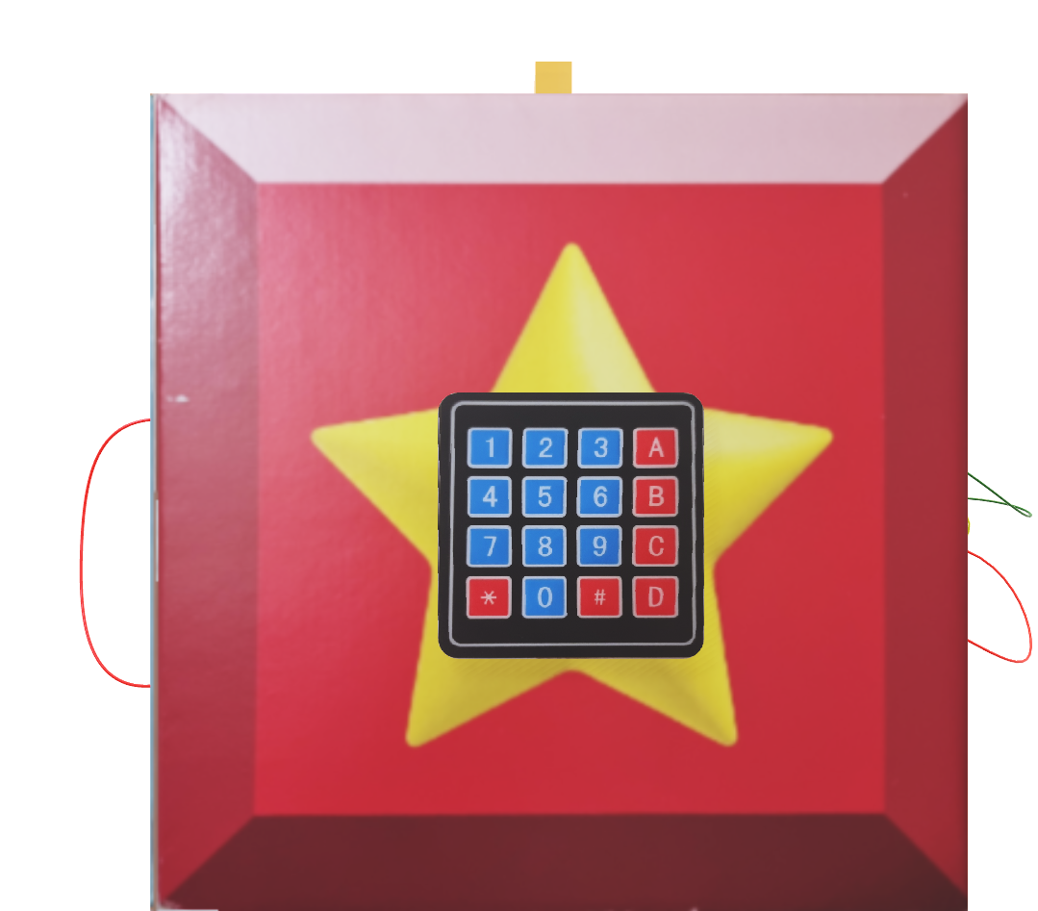
MODULES
CODECRACKER
Notes:
This one requires to insert the correct code to complete it.

Slide 6
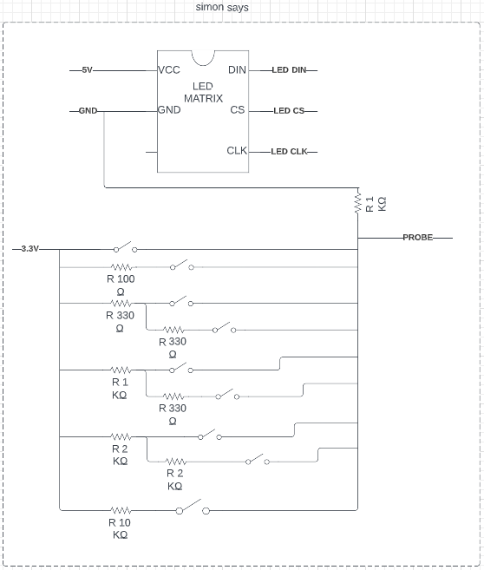
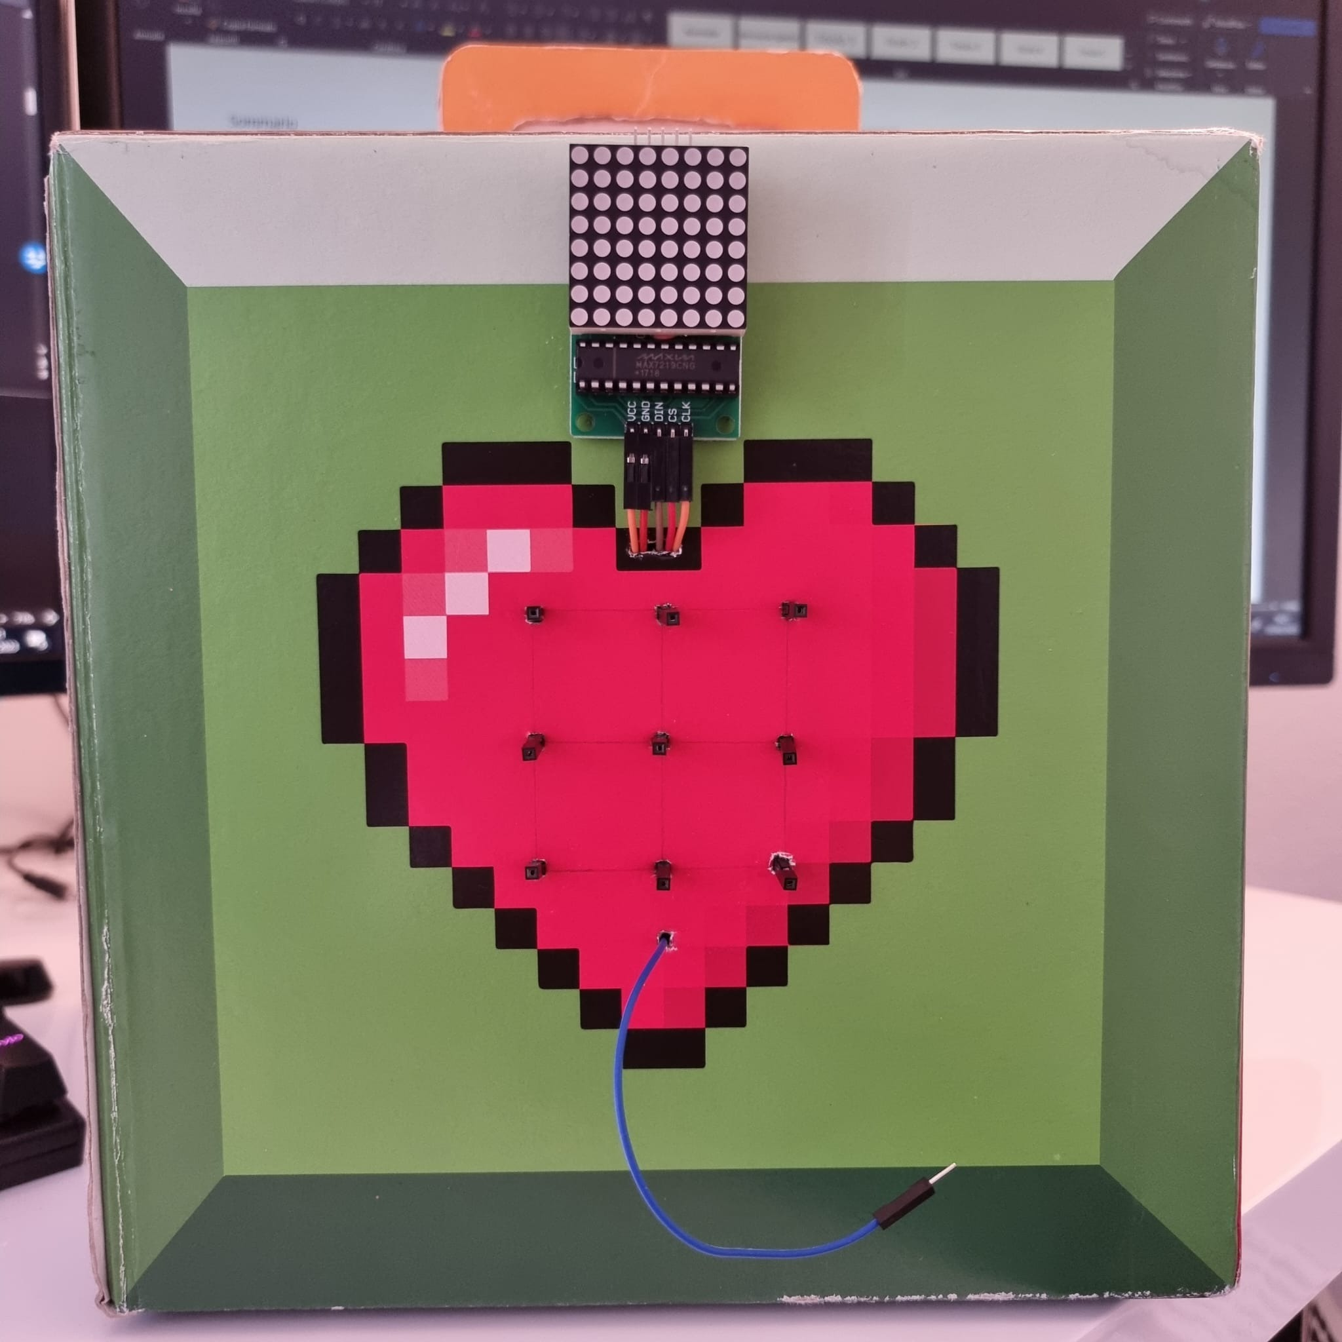
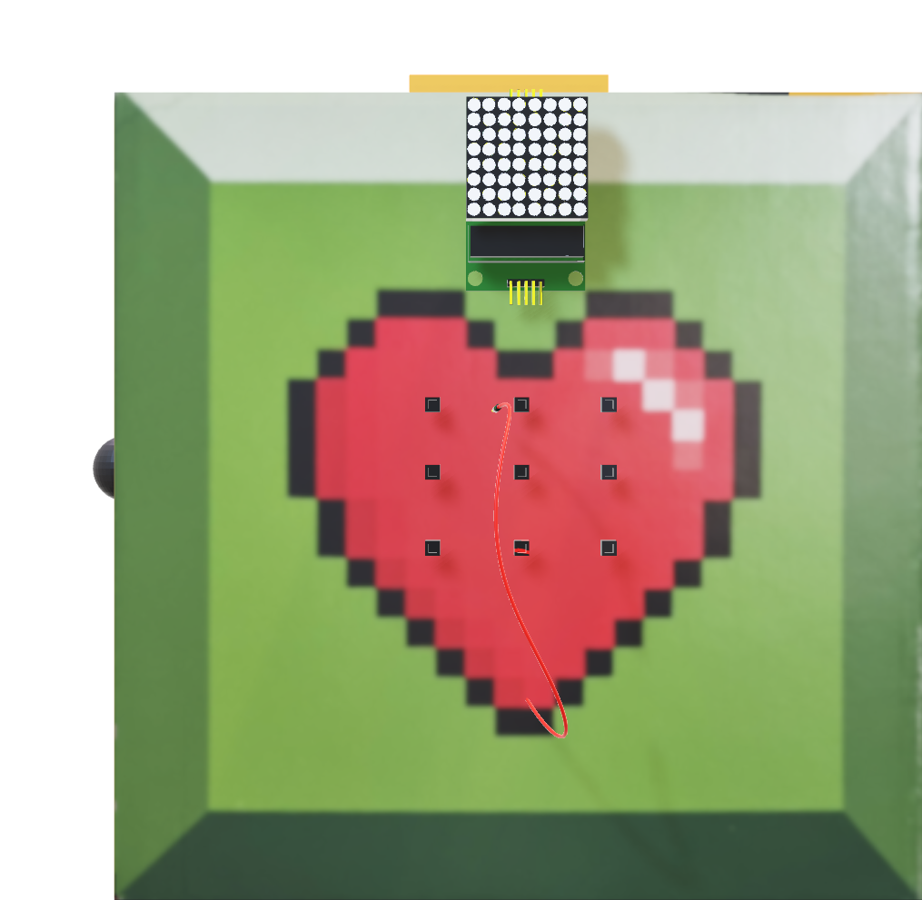
MODULES
SIMON SAYS
Notes:
In this game a 3x3 patter is shown in the led matrix, this corresponds to a slot to insert the probe in. The puzzle is then divided into multiple turns each having multiple steps, if an error occurs the players have to do it all over again.

Slide 7
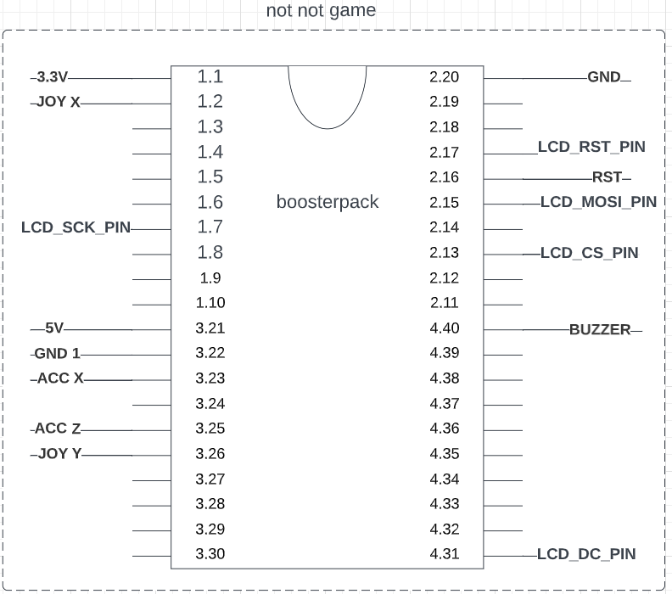
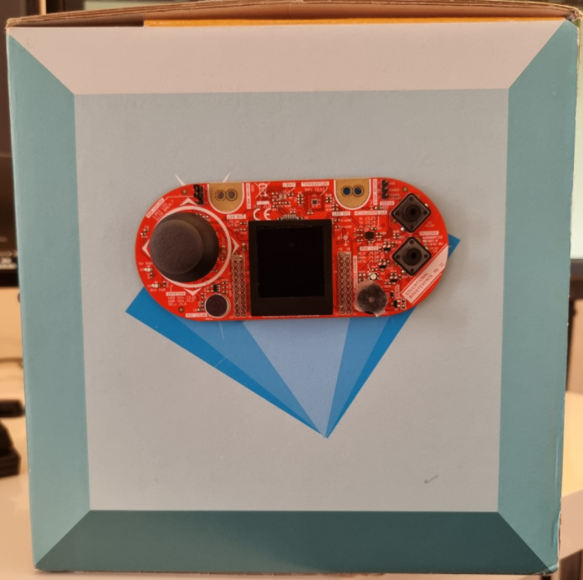
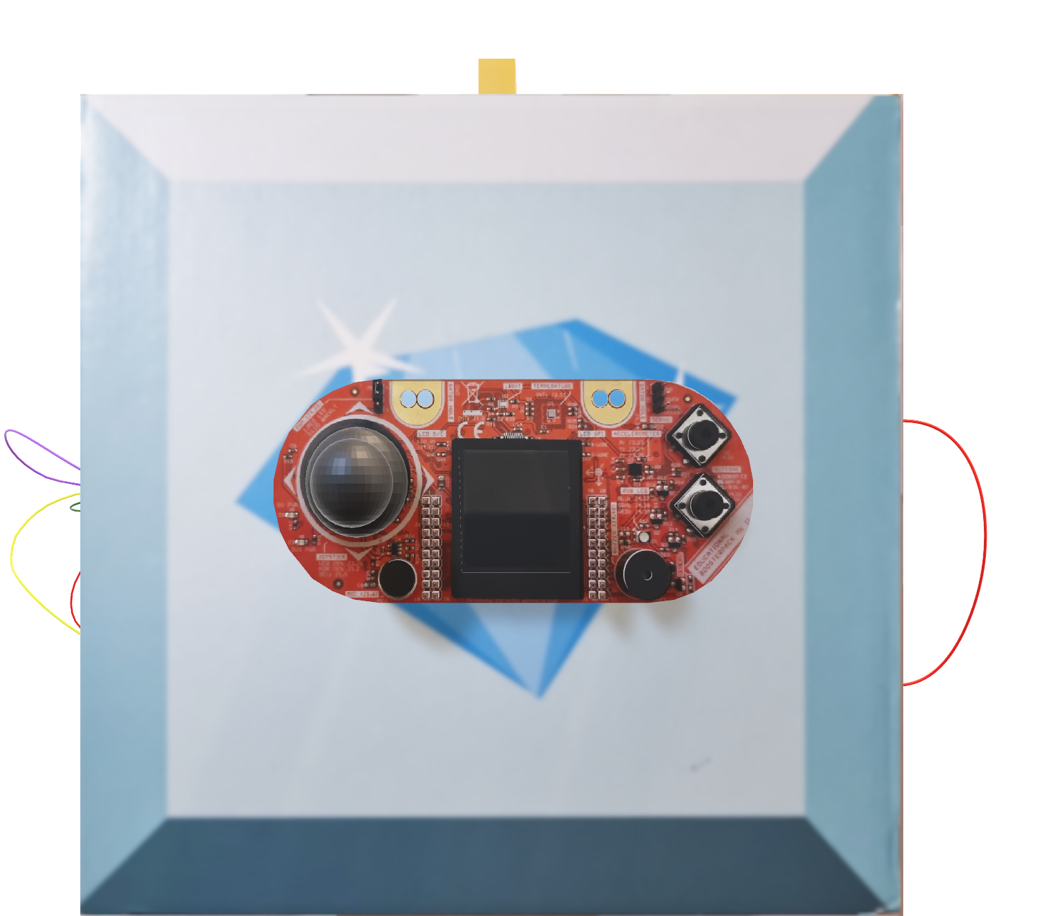
MODULES
not not yellow
NOT NOT
Notes:
Uses the LCD to show an instruction and the remaining time. We have to move the joystick in the right direction to advance. Each level has a decreasing amount of time to be completes.

Slide 8
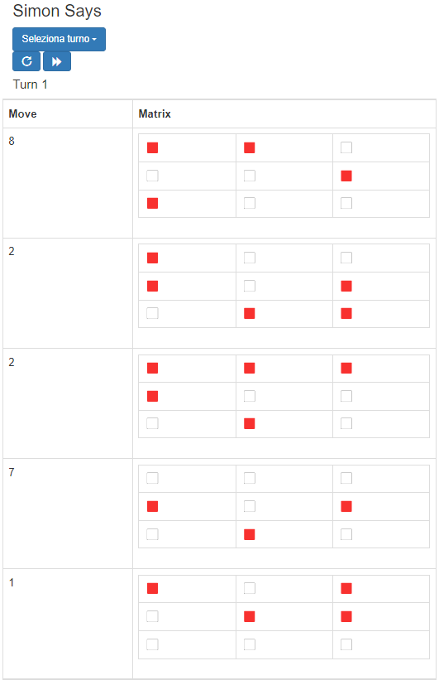
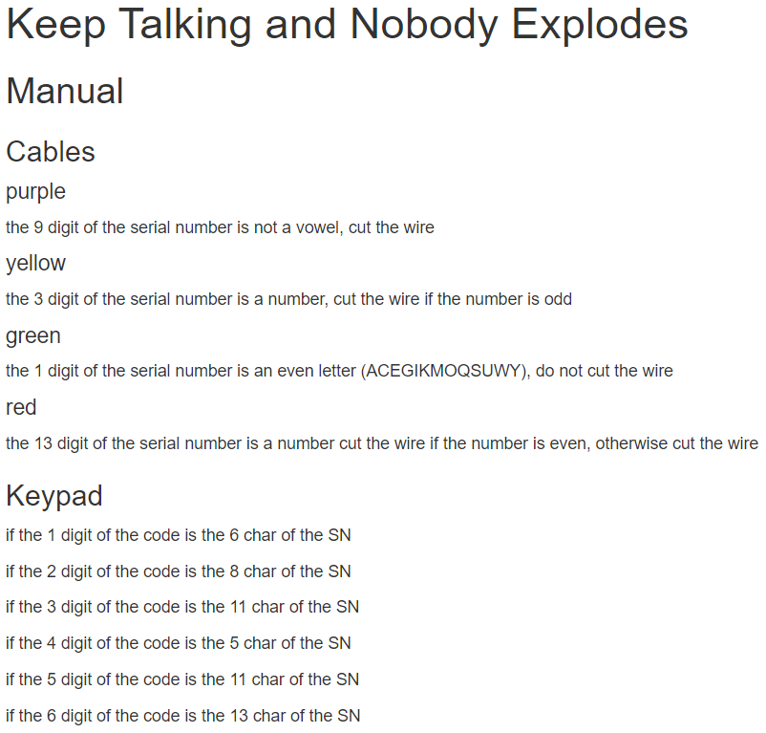
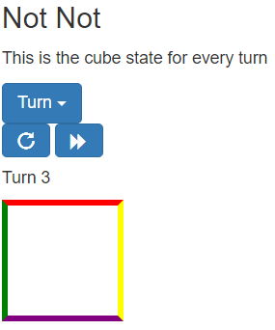

MANUAL
Notes:
This is what the other player sees, in here are collected the instructions to disarm the bomb. It was designed to have the communication as an essential step, having to relay information between the two players as the serial number, the instruction, and the pattern.

Slide 9
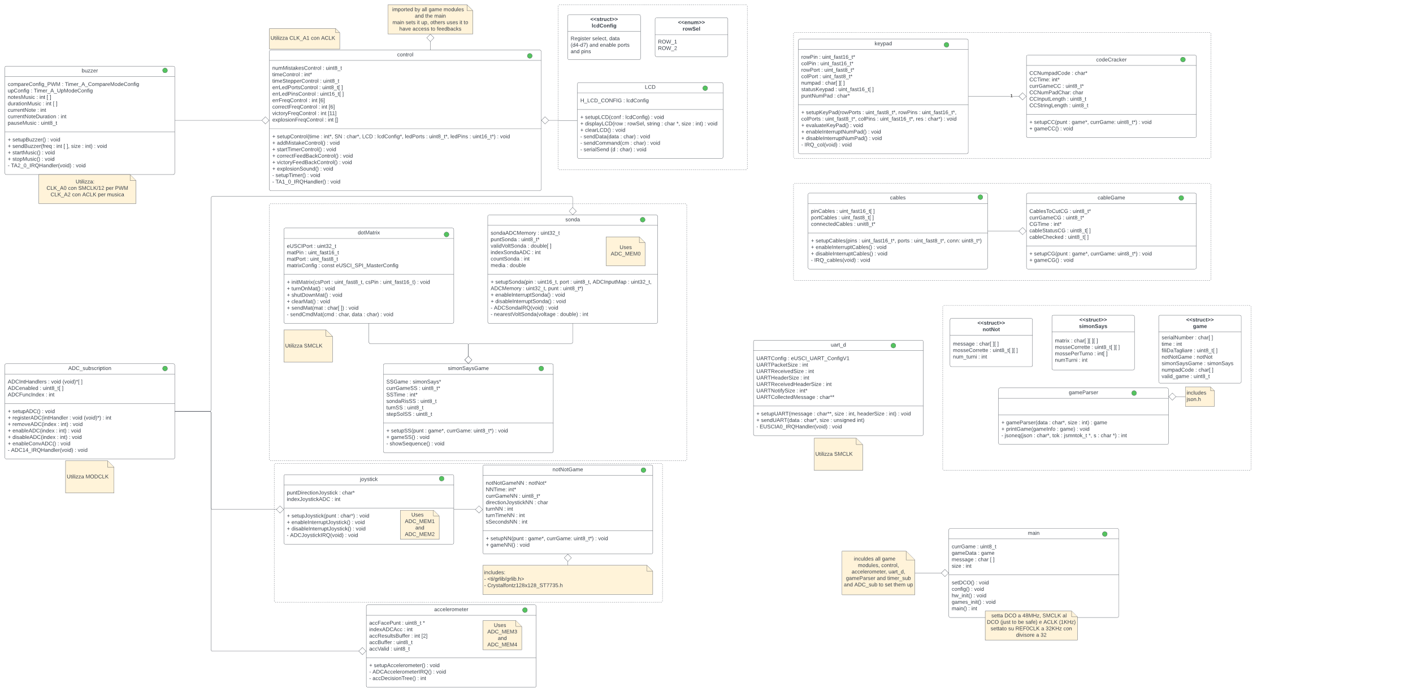

SW architecture
driver
game
driver
control
driver
driver
game
driver
driver
driver
driver
parser
game
subscription
driver
game
main
driver
Notes:
Here I’ll talk about the SW architecture. This as an overview of the modules of the system, that can be divided into different categories:
Drivers
The first one drivers. Those are the HW dependent code, they provide the interfaces to use the HW with a higher level of abstraction.
Interesting is the ADC_subscription driver, since it was one of the first modules developed and we didn’t know how the system would evolve, to be able to dynamically change the executing functions I chose to use a subscription system to not have to define multiple ISRs for the different states.
Control
Control is a mix of HW dependent and independent, it manages the countdown timer, the error count and the feedback to the user
Games
Games are the HW independent part of the application, they use the interfaces provided by the drivers to implement the game logic.
They use a sort of cooperative scheduling where the accelerometer is used as a scheduler and each game checks if it’s still its turn or not to pre-empt themselves.
Parser
Defines the structures containing the game information and parses the JSON of the game received through UART into them.
Main
The entry point of the application.

Slide 10
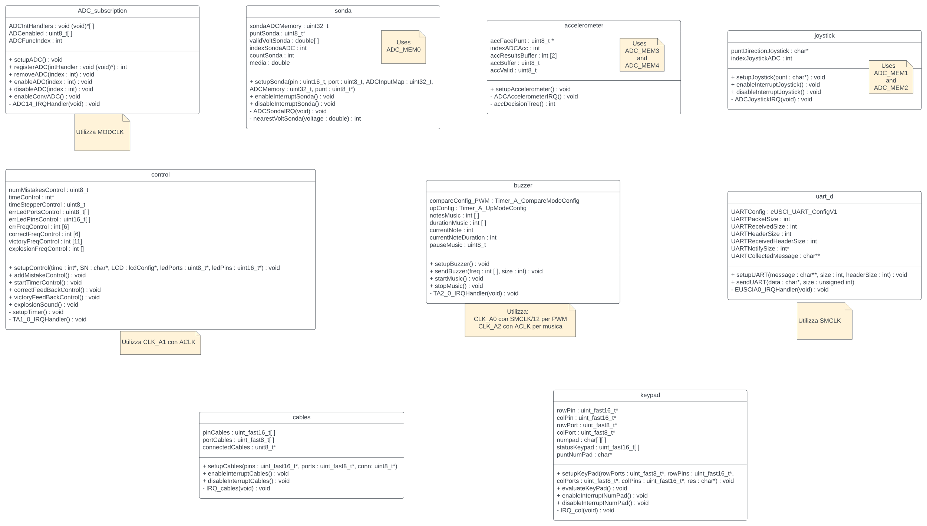
SW architecture - interrupts
ADC14
TA1_0
TA2_0
EUSCIA0
INT_PORTX
INT_PORTX
Notes:
Those are the modules that make use of interrupts.
ADC
For the ADC as said the interrupt is captured by the subscription module that then can call the accelerometer, the joystick and the probe.
TIMERS
Timer A1 is used by the control module to update the countdown, since it can be accelerated its period is 250ms. Timer A2 is used by the buzzer to control the music, its period is based on the tempo of the music and the scale factor when we accelerate it.
EUSCI
EUSCI is used to handle the communication “protocol” and receive the message from the connected device, in this implementation it is only used to communicate the JSON but it ca be used to have the two feedback each other on the game.
I/O PORTS
The interrupts on the GPIO ports are used for the keypad and cables, the pins are configurable and all the interrupts will be set to the same ISR.
The two may use the same ports, so methods to enable and disable the interrupts are used.

Slide 11
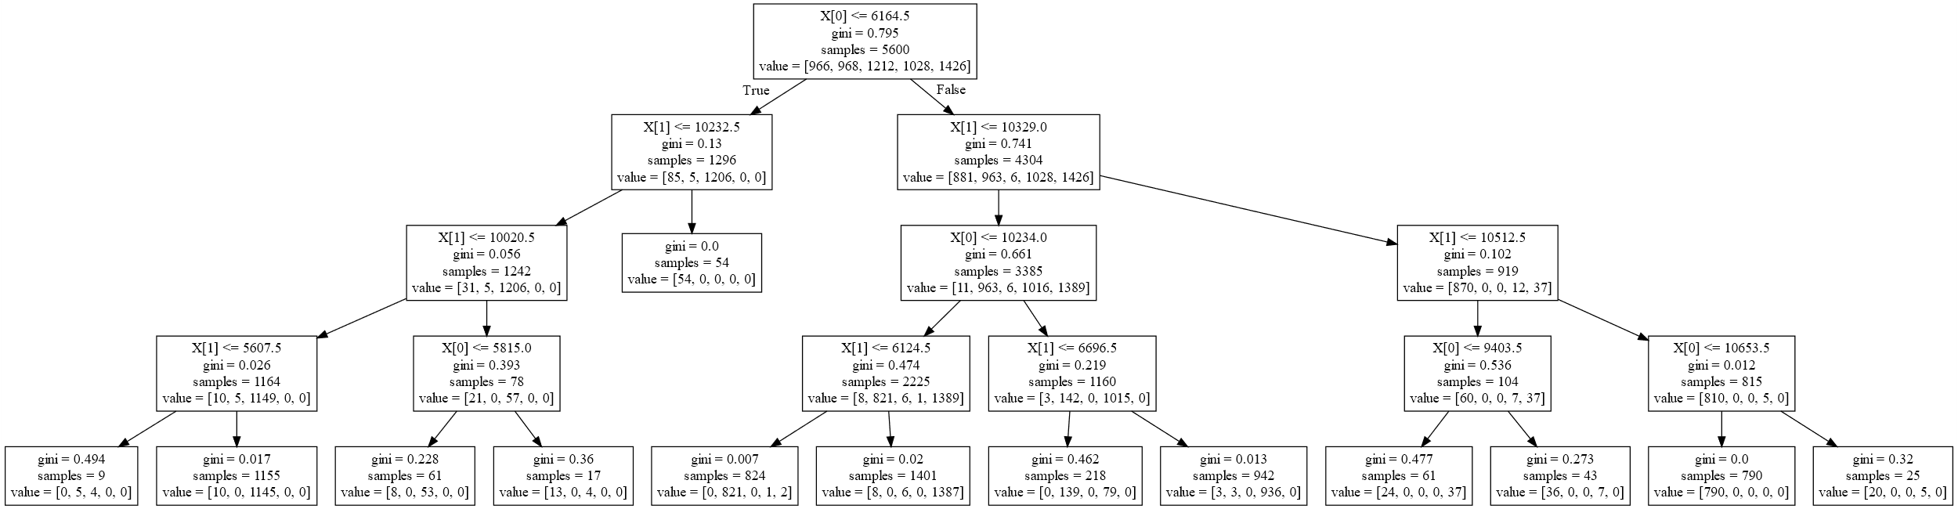
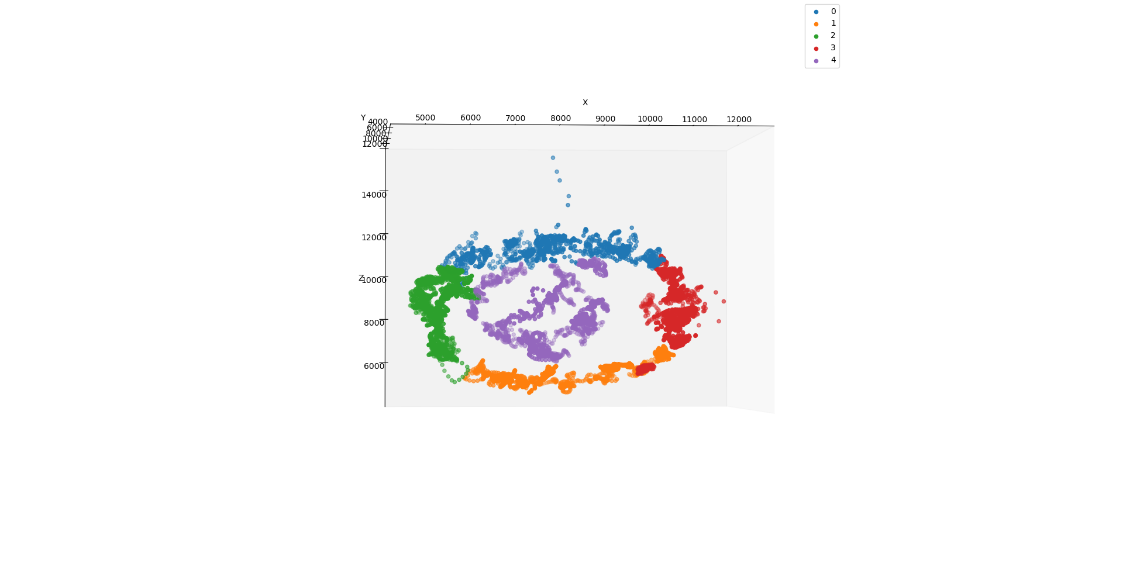
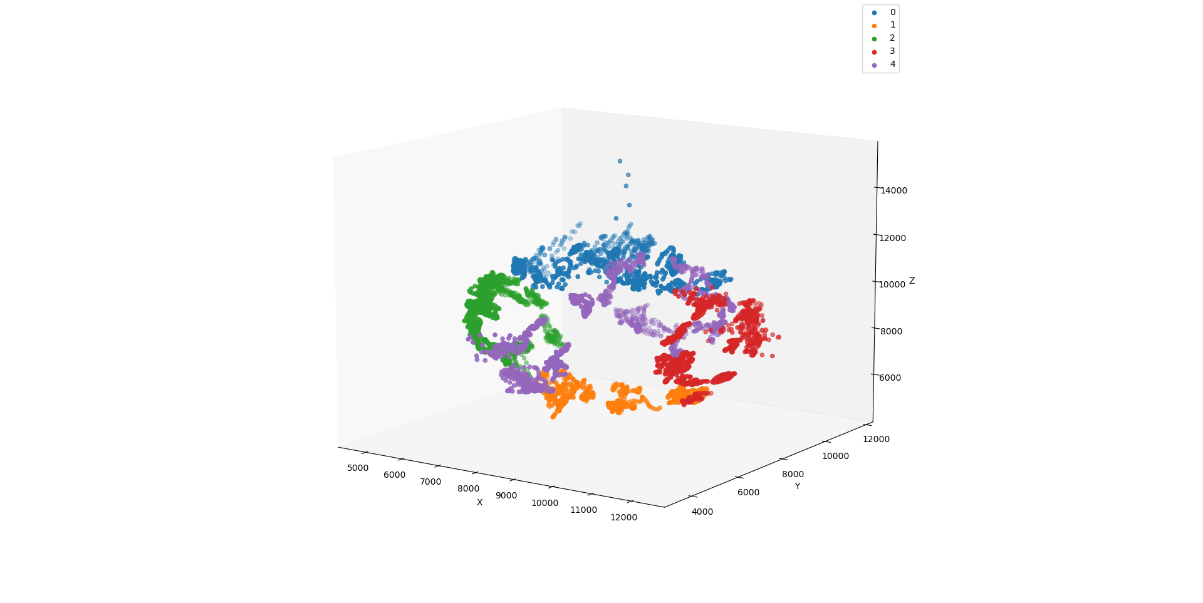
SW architecture - algorithms
sonda
int nearestVoltSonda(double voltage){
int i,near = 0;
double diff = -1; diff = voltage - validVoltSonda[0];
if(diff<0) diff = -diff; for (i=1;i<NUM_VOLT;i++){
double d = voltage - validVoltSonda[i];
if(d<0) d = -d; if(diff>d){
diff = d;
near = i;
}
} return near;
}
KNN
accelerometer
Decision tree
Notes:
Sonda
This is used to detect which of the 9 slot the probe is inserted in, it uses a very simple KNN with K=1, over the average of 150 samples.
Accelerometer
It uses a decision tree to set the current top face of the cube.
The tree was trained using data read from the sensor labelled from 0-4. Initially we used all the X, Y and Z axis but looking at the data since the top and bottom of the cube are classified into the same class we can only look at the X and Z, this is reflected on the training that gets us similar impurity with all three of them and just the X and Z.
Other interesting mentions are the joystick and the keypad

Slide 12
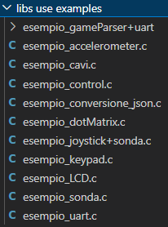
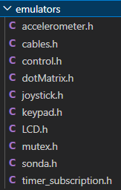
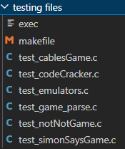
TESTING
DRIVERS
OTHERS
L’hardware è stato testato in modo intensivo nelle sue feature di sicurezza effettuando diversi corti e cavi connessi al contrario
Notes:
The testing can be separated between the HW dependent SW and the independent one.
Drivers
The dependent SW was tested using small programs that only used that part of the hardware, so it was easier to rule out problems.
Other
To test the independent SW I wrote some emulators that make use of threads to simulate interrupts and have the same interfaces as the drivers.

Slide 13

FUTURE WORK
Add a battery and a power button
Implement web server for the manual into a single package
Use UART to implement better feedback to the user using the manual
Notes:
These are some of the work that ca be done to improve the project

Slide 14

Davide Cavicchini

